Slide 1

Using AI For Magic 8Ball Mini-Project
Team 404

Slide 2
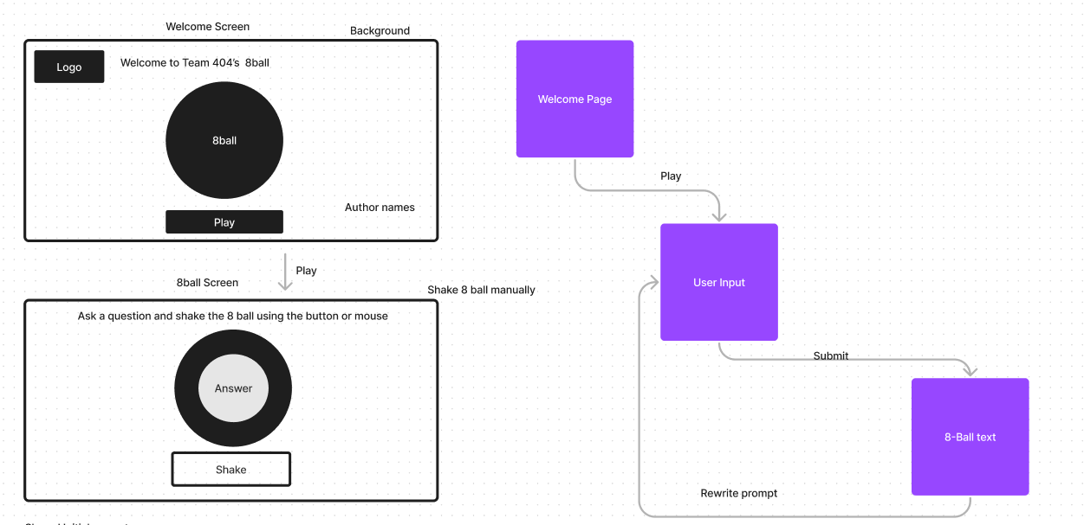
Diagramming
We used Figma to generate a concept as a team
Created mockups of each screen
Used these to generate ChatGPT prompts

Slide 3
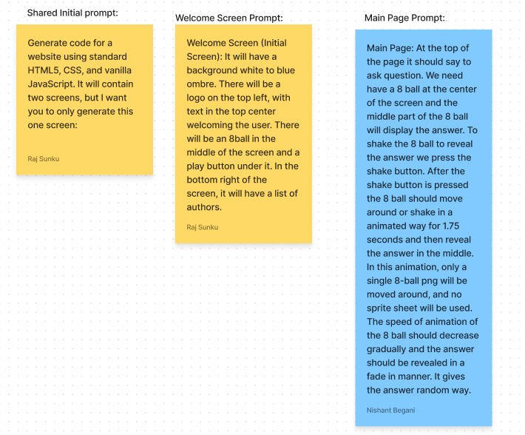
Making Prompts
Using the diagrams, we then made the following prompts
To be able to have multiple people generating prompts, we had a shared initial prompt, with different prompts for different screens

Slide 4
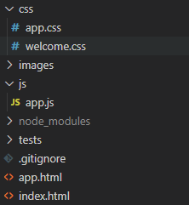
Using ChatGPT Output
Firstly, we just copy pasted the ChatGPT outputs into our files
The resulting web pages we got were slightly broken
However, it was fairly easy to fix those issues
So far, it was very easy and was very successful

Slide 5
Integration
Adding new features was very difficult
ChatGPT did not generate code that could easily be added to our current project
Mainly used sources such as W3 schools to help us
Was difficult to add these changes since we didn’t understand most of the initially generated code
Took a long time to combine the two screens and add background/shaking effects due to this

Slide 6
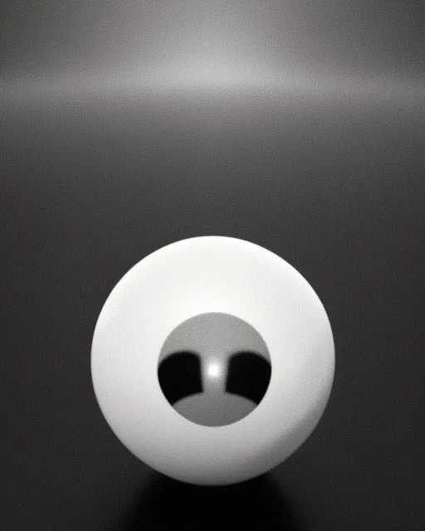
Art
There was no good free AI tool for art that we could find
Midjourney did not have a free trial, so we tried to use NightCafe and StarryAI
The resulting images were like this, not really helping us
Eventually just made our own assets using google images and photo editing tools

Slide 7
Advantages
It is useful to gain a jump start
It gives framework and mostly correct code, eliminating the need for tedious coding
It was useful when trying to ask basic questions to understand concepts
It gave us the code explanation/translation to understand the code generated.
When asked, it gave comments for most of the lines or headers of the code, which helped us navigate the code

Slide 8
Disadvantages
Code was not necessarily complete or consistent with itself
ChatGPT was unable to generate some of the more specific requests or debug effectively
If told to only code in CSS, it generated HTML code before generating the style sheet code
It was difficult to add onto the existing code since we didn’t fully understand code generated by ChatGPT
Simply no good AI art generation unless you pay money
Couldn’t suggest good structures of the play and the hake button.

Slide 9
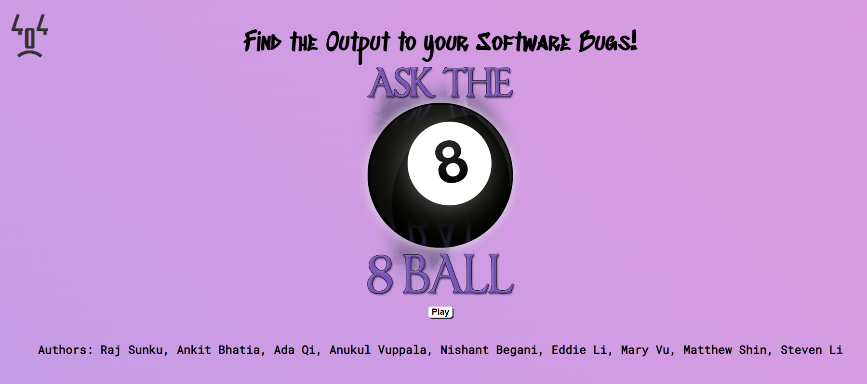
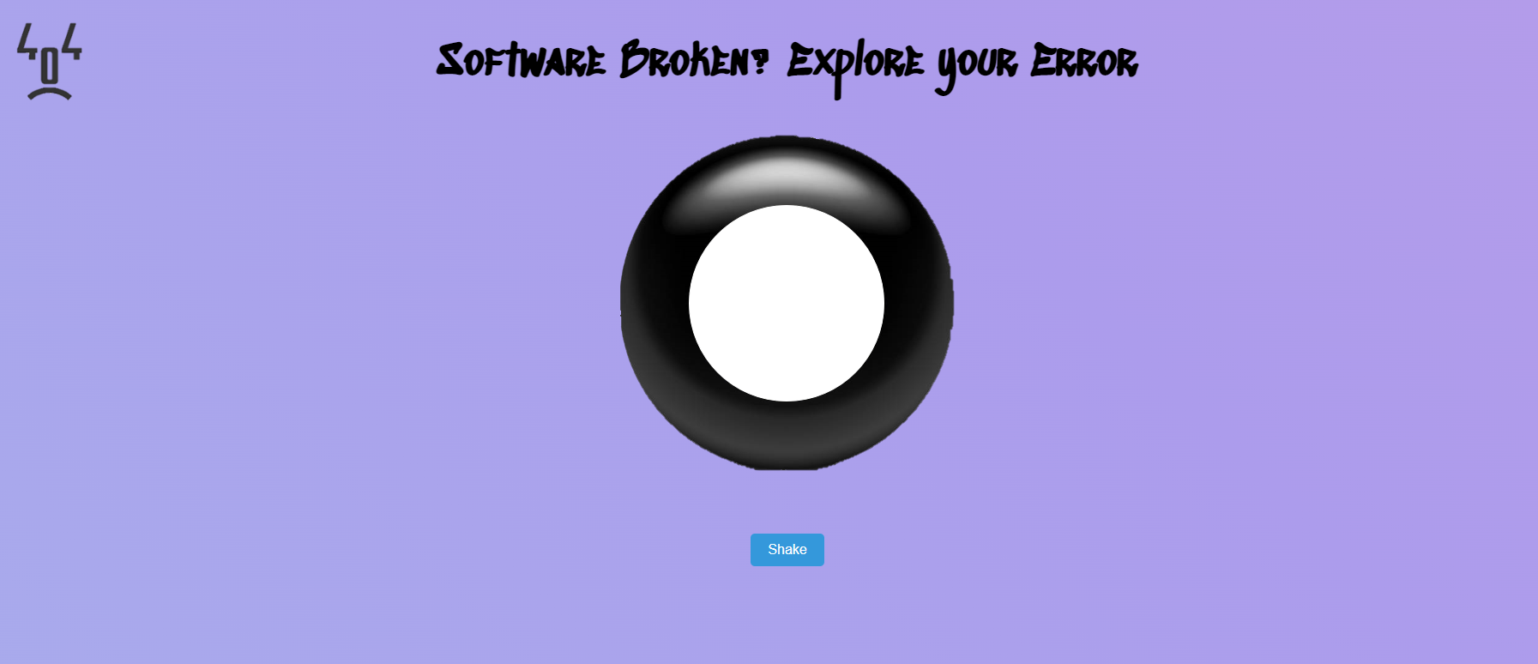
Final Product using Generative AI
Simple art with interactive background was generated.
Is user-friendly
Has a shaking animation for the 8 Ball.
Has a welcome screen that navigates to the main screen
Utilizes a font from google fonts

Slide 10
Conclusion
AI Tools have the potential to be useful when making projects
Use it sparingly and make sure to understand the code generated before actually implementing it
The jump start on our project initially seemed helpful, but it actually wasn’t since the rest of our project was more difficult to implement
Can possibly be used if you know exactly everything you want to make, but makes it very inflexible afterwards

